Slide 1
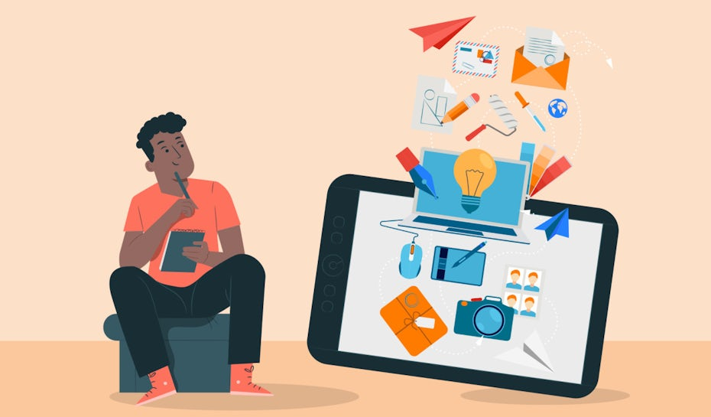
Advanced higher Graphic communication
Design Elements and Principles

Slide 2
introduction
In this lesson you will learn about the use Design Elements and Principles required for Advanced Higher Graphics.
The SQA still require you to have a knowledge of all the elements and principles from National 5 and Higher shown below.
Elements | Principles
Line | Balance
Colour | Alignment
Shape | Contrast
Texture | Depth
Value | Unity
Mass/Weight | Dominance/Emphasis
White Space | Rhythm

Slide 3
introduction
Line can connect parts of a layout, establish columns of text, create movement, define a shape, emphasise words and separate parts.
Balance refers to symmetry or asymmetry of a layout. Symmetrical balance gives equal weighting to each object whereas asymmetrical balance can create a more eye catching and visually appealing layout.
Alignment helps improve the structure and organisation of a layout. Elements can be left, centre or right aligned or aligned vertically and horizontally.
Colour can be used creatively to make things stand out, create visual impact, unify layouts, suggest moods and connect with the target market.
REVISION: HIGHER DESIGN
ELEMENTS AND PRINCIPLES
Contrast is about opposite such as shapes, colours, sizes, typefaces and so on. They help create a high visual impact or make certain objects stand out.
Elements | Principles
Line | Balance
Colour | Alignment
Shape | Contrast
Texture | Depth
Value | Unity
Mass/Weight | Dominance/Emphasis
White Space | Rhythm
Shape can frame parts, organise layouts, create order, or create visual impact and contrast.
Depth is used to create visual impact, generating layers that make objects appear to pop out of the page or recede into it, creating depth.
Texture gives a design a look, feel, a surface. Physical texture can be felt through paper types, and visual can be created by printing a surface on the paper.
Unity refers to connecting elements on the page that share similar attributes, such as colour, shape, size, typefaces etc. This helps tie elements on the page together.
Value is how dark or light elements are. White is the lightest value and black is the darkest.
All colours have a value and sit within a range of light to dark.
Dominance occurs when one items stand out more than other, usually the largest. Emphasis happens when one item is made more eye-catching.
Rhythm is used to achieve visual progression of repeating elements in a varied pattern, such as similar shapes in a layout, repeated elements on every page.
Mass equals size. Large graphics that take up lots of space have a large mass. It would have less mass if the image was small and there was more text on the page for example.
White space is any section of a document that is unused or space around an object. It can create rest for the eye, provide breathing space and improve readability. It can give focus to an object and direct the viewer’s eye.

Slide 4
introduction
The Elements and Principles required for Advanced Higher are:
ADDITIONAL: ADVANCED HIGHER DESIGN
ELEMENTS AND PRINCIPLES
Elements and Principles
Golden Ratio
Rule of Thirds
Pace
Dynamic Effects
Focal Point
Radial Balance
Negative Space
Silhouttes

Slide 5
Golden Ratio
What is the Golden Ratio?
Golden Ratio – 1.618
A grid (also drawn as spiral) that divides the page and helps define an aesthetically pleasing layout. The spiral leads the eye to the main focus of the page at its centre.
Making use of the Golden ratio makes the layout more pleasing to the eye. The reason for this is it mimics the ratios, found in nature e.g a sea shell.

Slide 6
Rule of thirds
What is the rule of thirds?
When a page is divided up horizontally and vertically using a grid into thirds.
Important features are placed in the points where the grid lines cross
The effect of using the rule of thirds is to draw the eye to these points on the page. Designers will position the things that grab the viewers attention in these potions. They may also place a piece of information they want the consumer to remember.

Slide 7
pace
What is Pace?
Techniques used by the designer can slow down or increase the speed with which a message is communicated. An advert on the side of a bus will have large text and eye catching images getting the message across quickly. A newspaper article would have a slow pace. If you identify rhythm in DTP item pace is how fast or slow it is.
The often designer uses pace to create a certain feel on the page and/or to communicate with a particular audience. An DTP document with quick pace will often appeals to youthful audience or be about a subject that is fast pace, for example racing or superfast broadband.

Slide 8
Dynamic effects
What is Dynamic Effects
Manipulating images like those below and text along a path are some ways of increasing the movement or flow on a page. These create what are known as dynamic effects.
Dynamic effects are more than just a blurred image created when a camera takes a picture of a fast moving image. It involves additional effects added by the designer.

Slide 9
Focal points
What is Focal Points?
A focal point is created by arranging and/or sizing components to lead the eye to a feature or to a specific area of a page. It can also be done by editing on image so that one area is in focus/in colour. Effective use of a golden section or rule of thirds can create a focal point.

Slide 10
Radial balance
What is Radial Balance
In addition to symmetrical and asymmetrical balance a layout can spiral from a point on the page creating radial balance.
Features on a page placed in a radial balance seem to 'radiate‘ out from a particular point in a circular fashion.

Slide 11
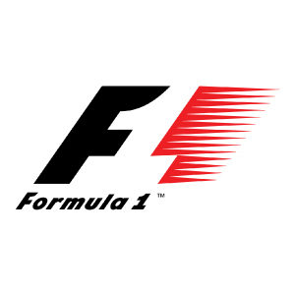



Negative space
What is Negative Space?
Negative space is the space around and between the subject(s) of an image. It is more than just white space because it is used to communicate information.
The negative space in this example is actually the dog. The cat etc… is the positive space (because it would be printed). The dog is not white space because it is used to communicate information and not to give the viewers eyes a rest.

Slide 12
silhouettes
What is Silhouttes?
A dramatic effect create by a clear outline and black filled image.
A dramatic effect create by a clear outline and black filled image in this case the soldiers against the sky.

